Slide 1
Team Project: COVID-19 Death Rates
Team Number 8: Clare Huang, Xiaomei Hai, Zach Pelikan, Pamela Deane, Joshua Ippolitov

Slide 2





Meet the Team!
Zach Pelikan
Modeler
Xiaomei Hai
Data Engineer
Clare Huang
Project Lead
Data scientist
Pamela Deane
Data Analyst
Joshua Ippolitov
SME/Functionalist

Slide 3
Business Understanding
Business Problem
We want to develop a machine learning model that uses different types of data to predict COVID-19 death rates for each FL county. We hope to discover a trend in why the counties differ.
Success Definition
We are looking for the most explainable model with the highest predictive accuracy. The model needs to display a clear causation from the varying factors, whatever is built is to be capable of updates and replication
Domain Understanding
Deeply understand the potential reasons for varying COVID-19 death rates between FL counties and success criteria
Search for different data sets that can provide the necessary information to make a determination
Use the file Flinfo2022.csv

Slide 4
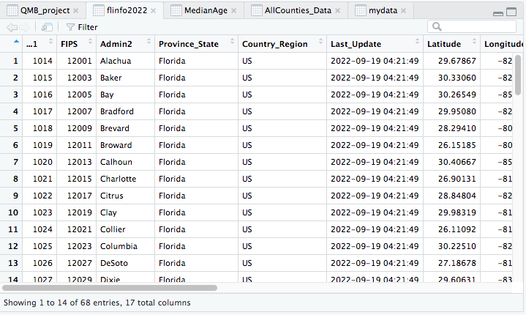
Data Understanding
The starting dataset: flinfo2022

Slide 5
Data Understanding: Data Dictionary
Matrix with 67 rows and 17 columns giving the following statistics
Confirmed: Number of official COVID-19 cases
Deaths: Number of official COVID-19 deaths
Incident rate: How quickly disease occurs in county
Case Fatality Ratio: Proportion of those with disease that turns fatal
Lethality: Percent of those infected that die
Population: Total population in that county

Slide 6
Data Preparation
Data for poverty rate: Percent of a counties population that lives in poverty
https://www.indexmundi.com/facts/united-states/quick-facts/florida/percent-of-people-of-all-ages-in-poverty
Data for age: Median age in each county
https://www.flhealthcharts.gov/ChartsReports/rdPage.aspx?rdReport=NonVitalIndRateOnly.TenYrsRpt&cid=300
Data for hospital density: Number of hospital beds per 100,000 people
https://www.flhealthcharts.gov/ChartsReports/rdPage.aspx?rdReport=NonVitalIndNoGrp.DataViewer&cid=313
Data for population density: Population per square mile
https://worldpopulationreview.com/us-counties/states/fl
Data for people fully vaccinated rate: 2 dose
https://data.democratandchronicle.com/covid-19-vaccine-tracker/florida/12/

Slide 7
Data Preparation: Extract, Transform, Load
Poverty Rate
No CSV available, data individually loaded into excel
Miami-Dade data missing, separate research to fill in
Age
Exported into excel
Previous years deleted
Florida row deleted
County names reorganized
Hospital Density
Exported into excel
Irrelevant columns deleted
County names reorganized
Population Density
CSV file imported into excel
Reordered into alphabetical order
Adjusted order further to match previous data sets
COVID-19 Vaccination
CSV file imported into excel
Reordered into alphabetical order
Adjusted order further to match previous data sets
Lethality
Exported into excel
Previous years deleted
Irrelevant columns deleted

Slide 8
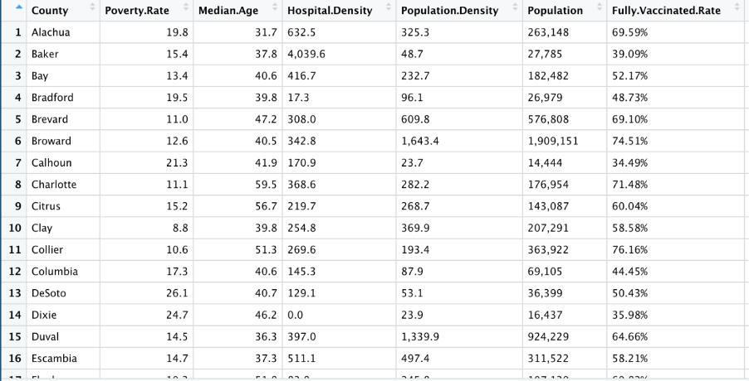
Data Preparation
All files were combined in excel, prior to being imported into R
Data Frame: QMB_project

Slide 9
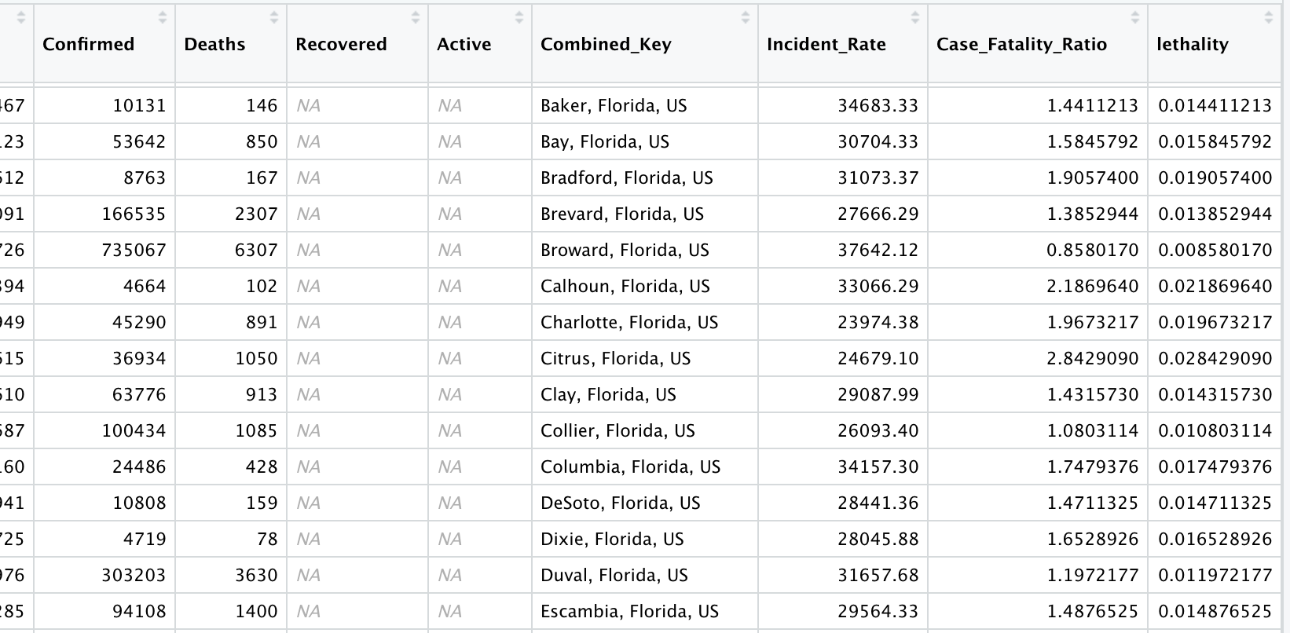
Data Preparation
Merged newdata with lethality and delete other column (e.g. poverty, mdage, hospitalden, popden, pop and vaccination) to get ready for modeling

Slide 10
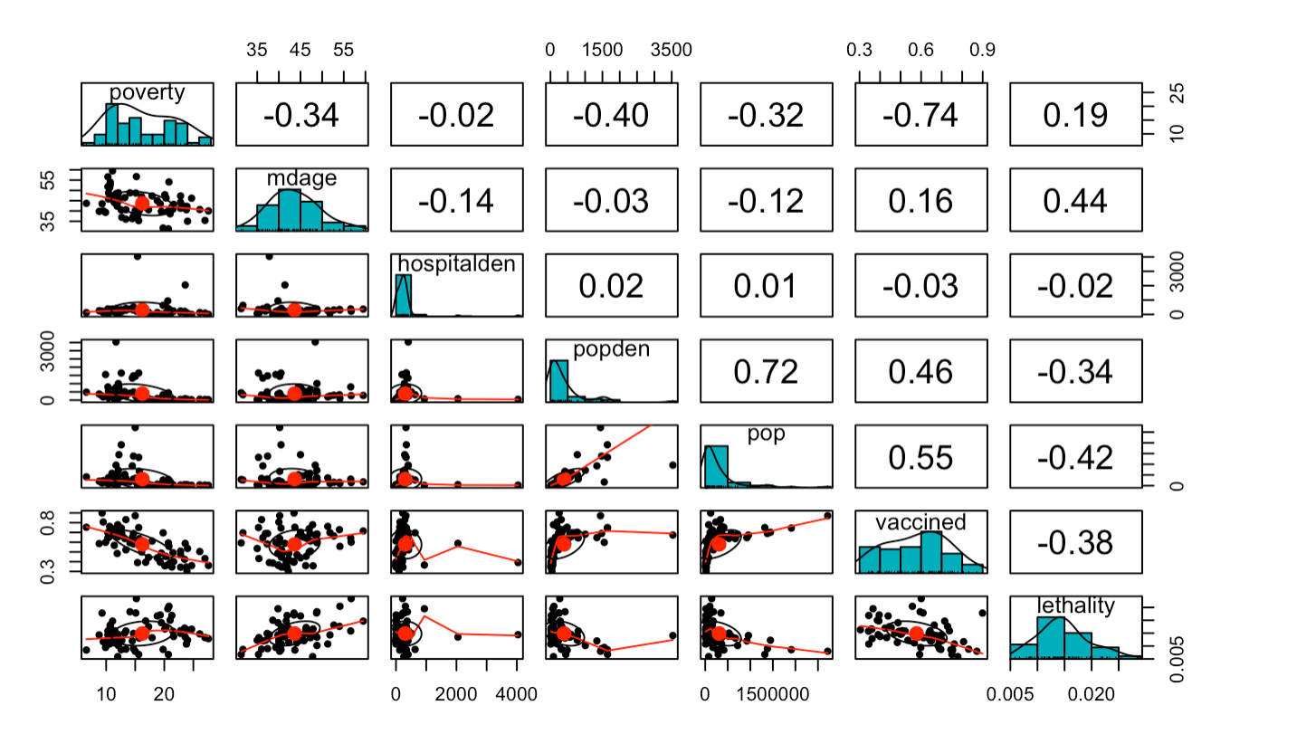
Modeling
Reviewed the scatterplot using Pearson correlation method

Slide 11
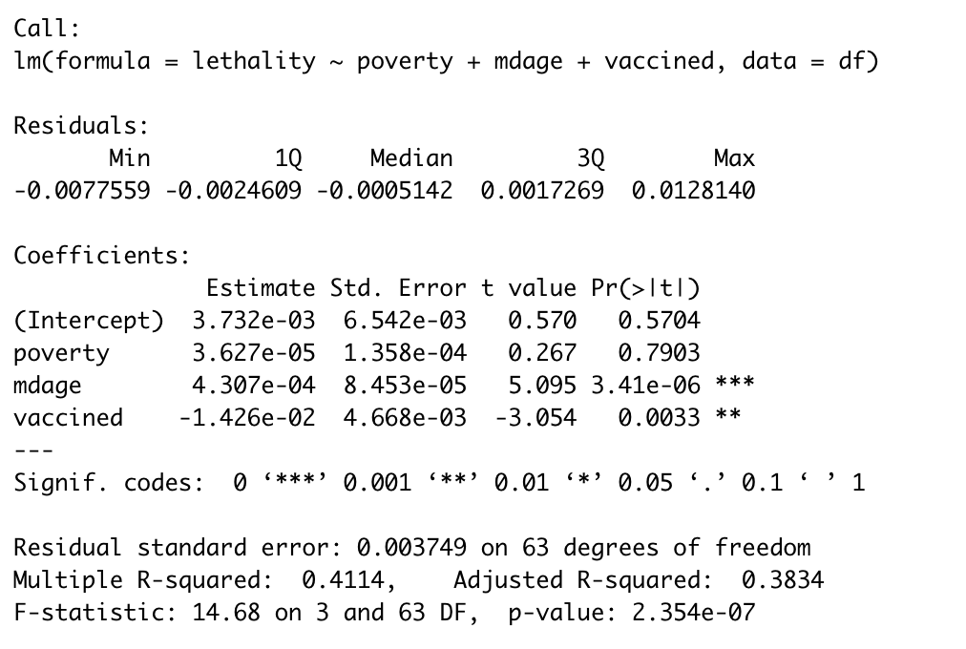
Modeling
As can be seen by the summary, poverty, median age, and vaccination status can explain 38% of the lethality of COVID-19. Age was the most statistically significant predictor of lethality, followed by vaccination status. Poverty was not a statistically significant predictor of lethality.

Slide 12
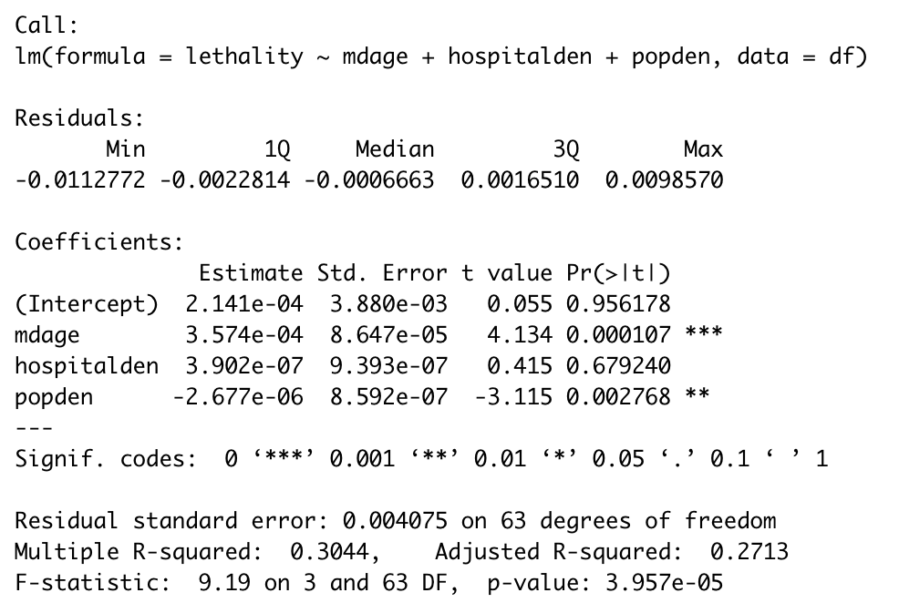
Modeling
As can be seen by the summary, median age, hospital density, and population density can explain 27% of the lethality of COVID-19. Age was the most statistically significant predictor of lethality, followed by population density. Hopsital Density was not a statistically significant predictor of lethality.

Slide 13
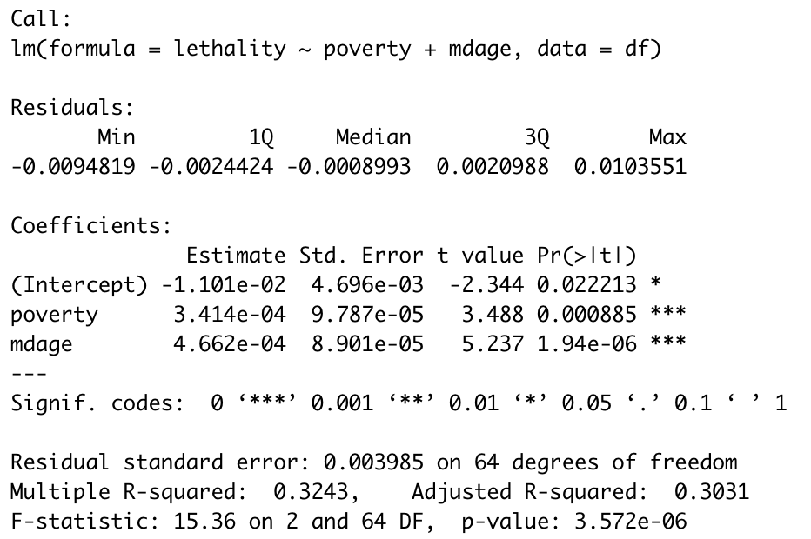
Modeling
As can be seen by the summary, poverty, and median age can explain 30% of the lethality of COVID-19. Age and Poverty both had high statistical significance as predictors of lethality. Unlike in the first model, Poverty is significant, which suggests that vaccination status and level of poverty have multicollinearity.

Slide 14
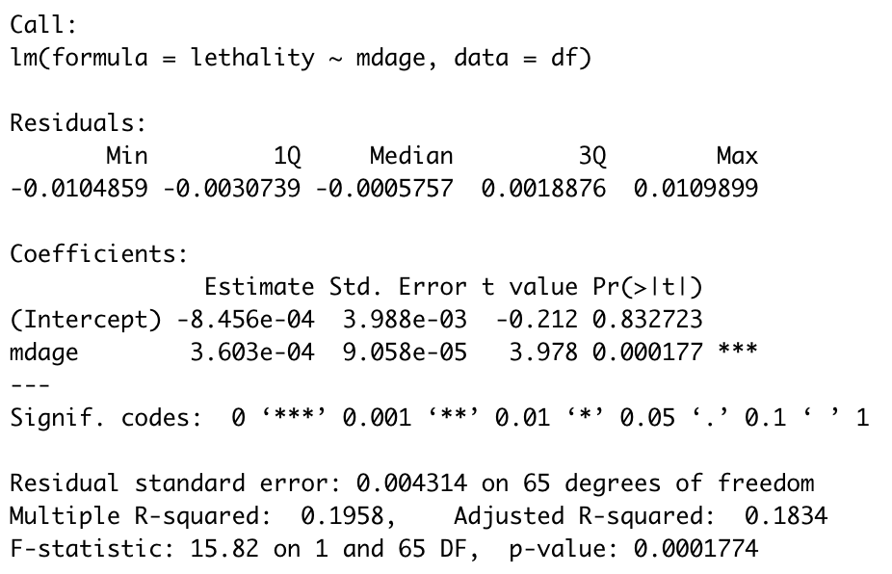
Modeling
As can be seen by the summary, median age can explain 18% of the lethality of COVID-19. Age has a high statistical significance as a predictor of lethality.

Slide 15
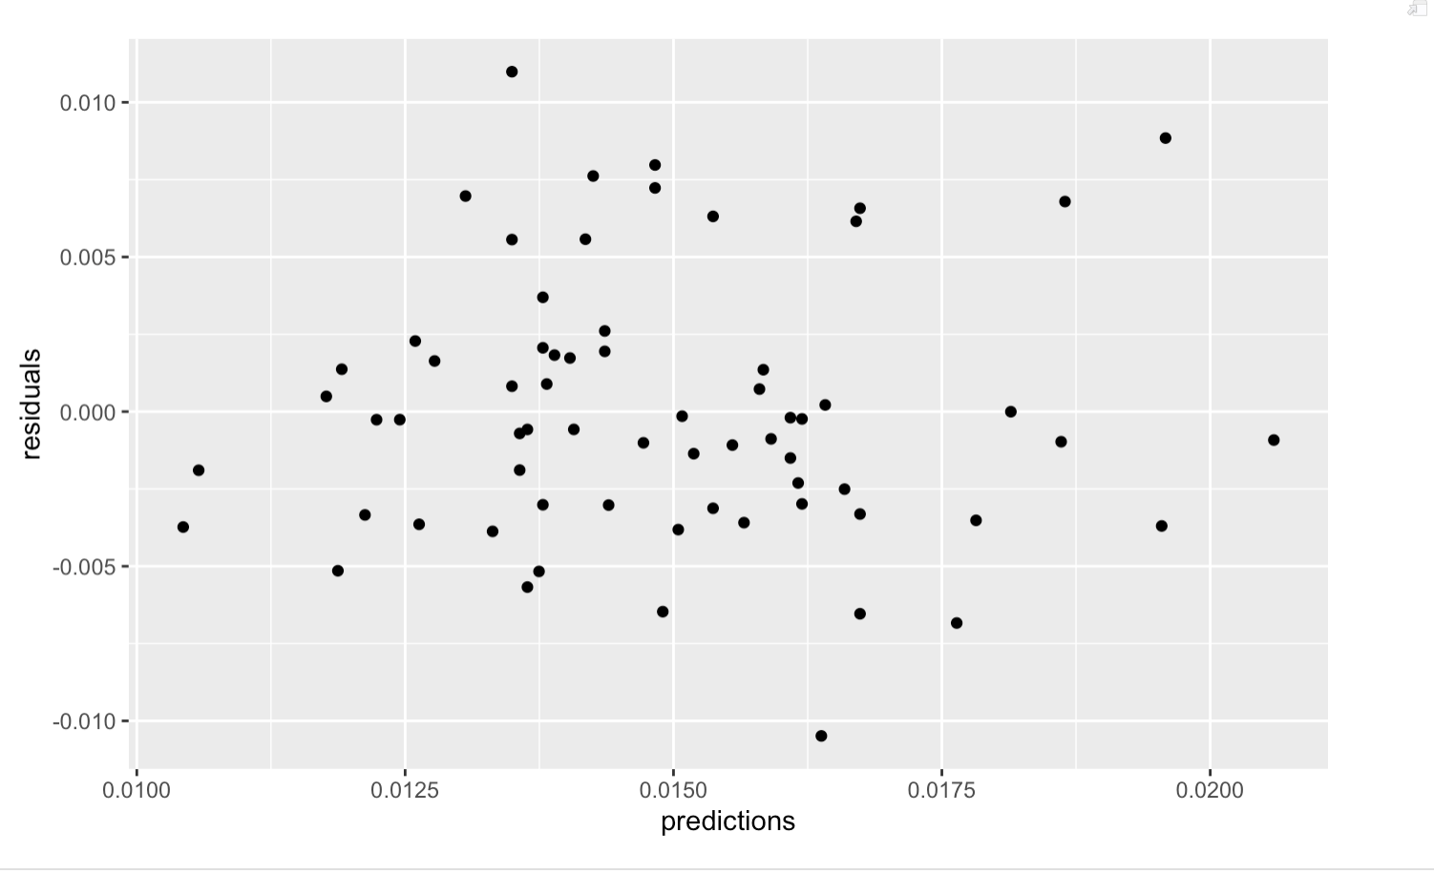
Modeling
Checked for independence of residuals across observations, x variable, correlation, homoscedasticity and adding the predictions to the mydata data frame.

Slide 16
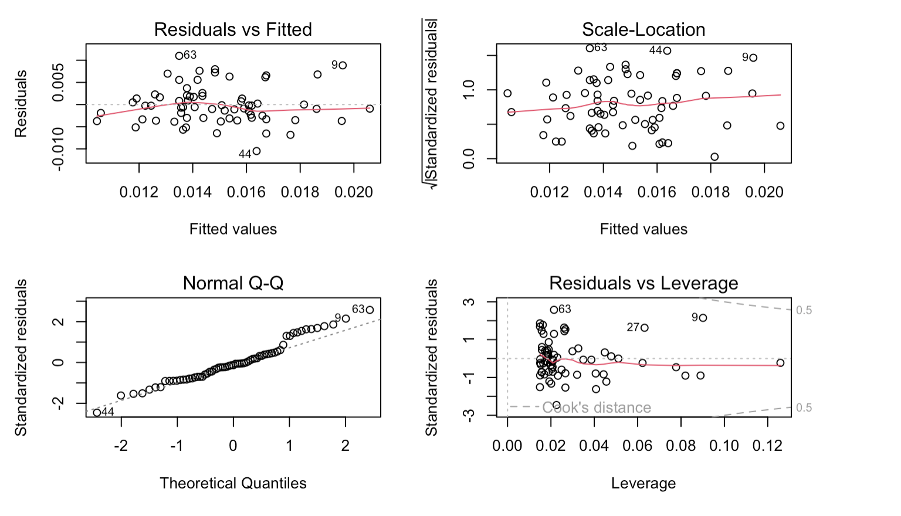
Modeling
Upon testing for normality of residual distribution and went through BP test, a statistical test and diagnostic plot for constant variance is the spread-level plot, We completed the testing for our model.

Slide 17
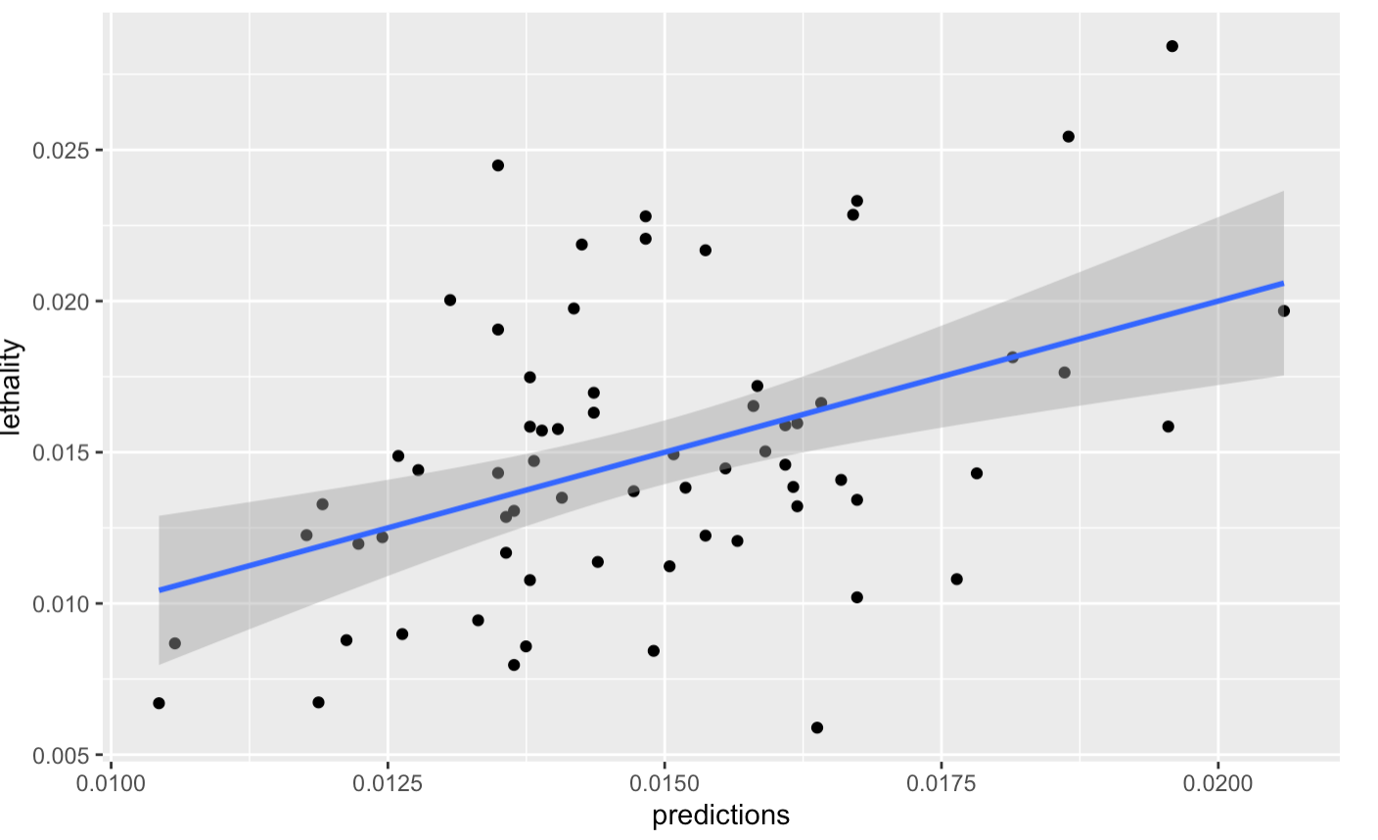
Evaluation
Per check, it seems that we can reach a higher collinearity for this regression predictive model by adding more variables.
To elevate the P value for our model(currently 38% to explain lethality)
We should add more than 5 variables which are highly related to the actual causes of C19 death rate to make this model to match business needs more.
Compared the actuals versus the predicted values

Slide 18
Deployment
Optimize the model by adding more variables which is expected to elevate the P value. (potential indicators: Diabetes rate, number of ventilators per county, educational attainment)
Biotechnology science company and pharmaceutical factory can use this model’s optimized version to facilitate market/investment research to look out C19 death rate for certain areas.
Business entities may add more variables to the model to analyze and predict the impact of their products to existing C19 lethality.
Since age is the most significant indicator to C19 death rate, business entities can address this point to C19 related products development and business operation process in post-pandemic era.

